Slide 1
JUnit And Mockito
By Janmejaya

Slide 2


Slide 3

Agenda

Slide 4
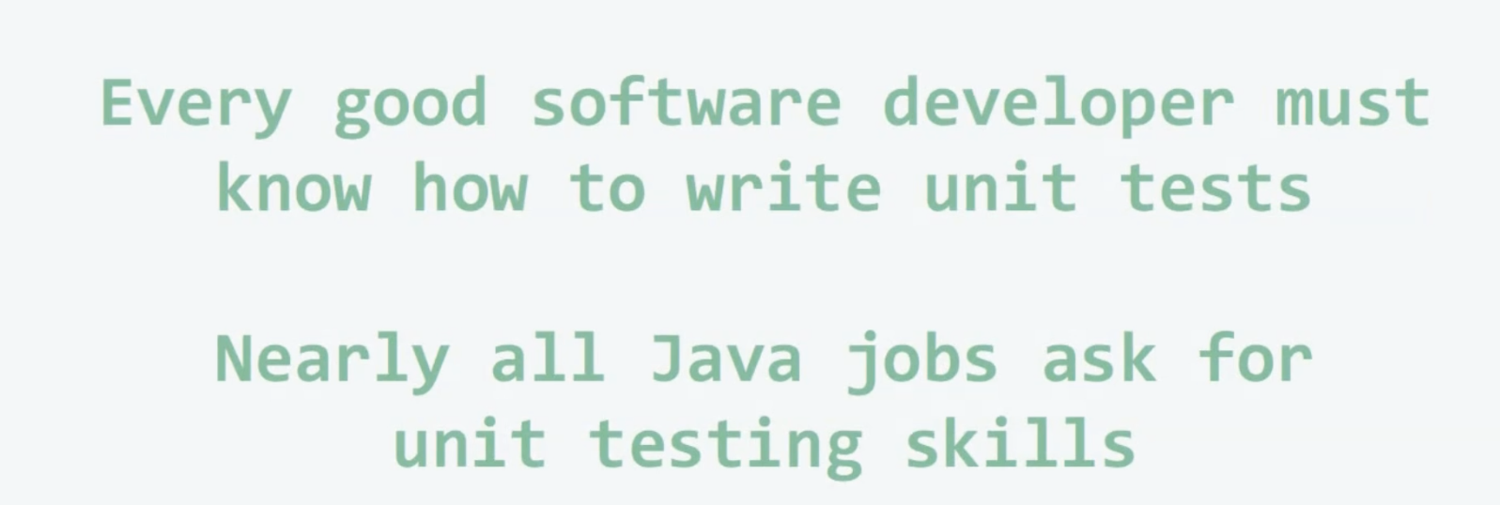
Why Unit Test?

Slide 5


Slide 6
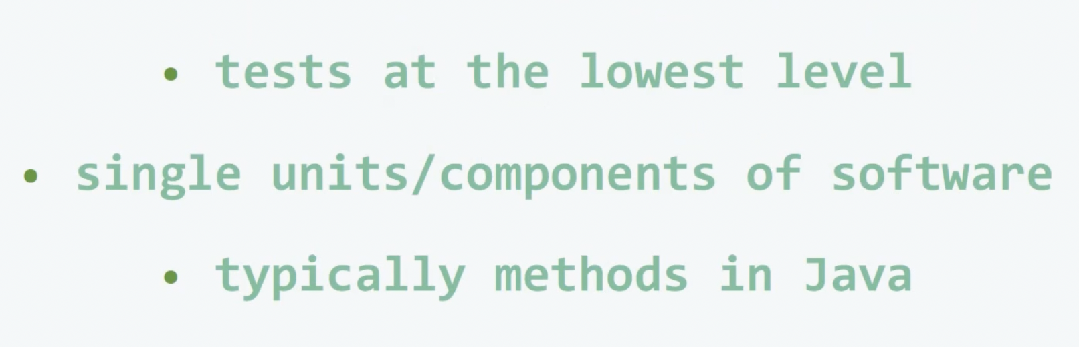
What Are Unit Tests?

Slide 7
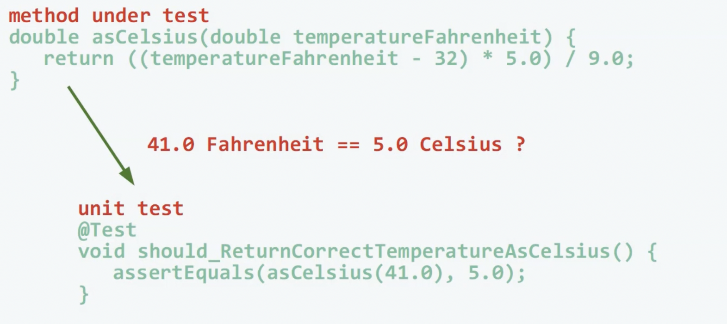
What Are Unit Tests?

Slide 8
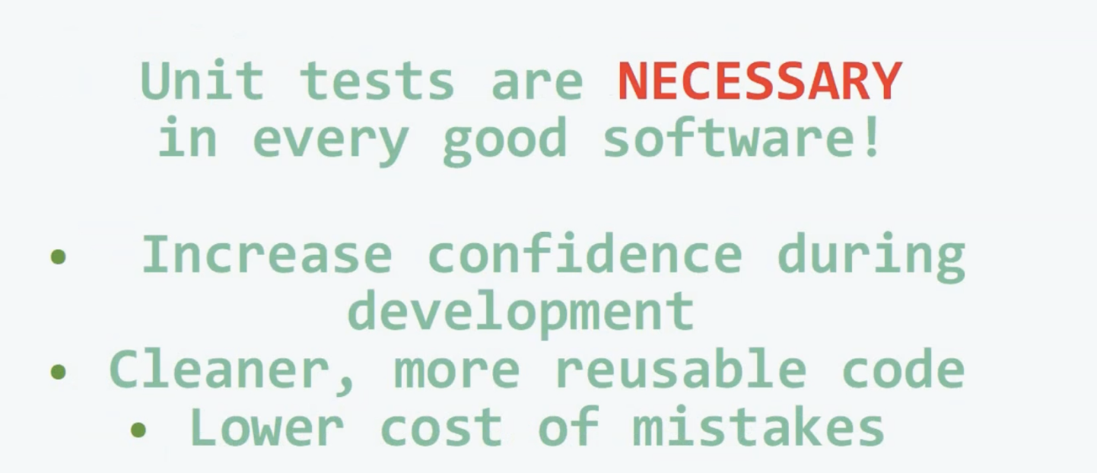
Are Unit Tests Necessary?

Slide 9
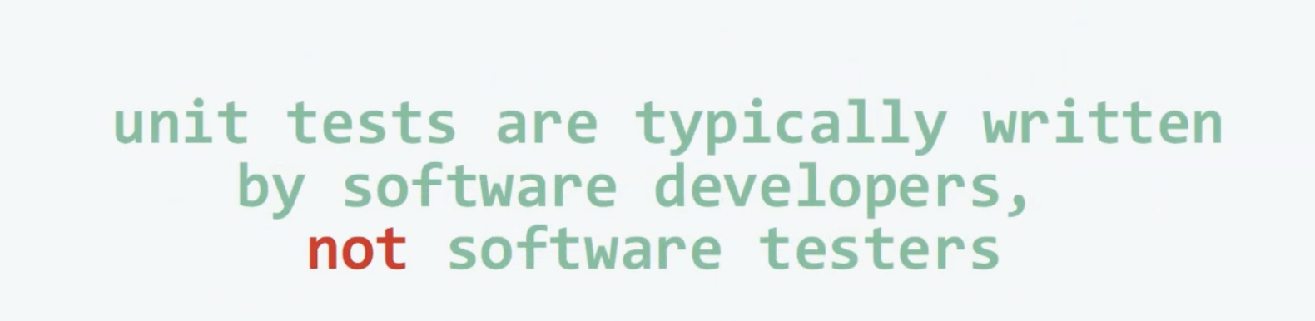
Who Writes Unit Tests?

Slide 10
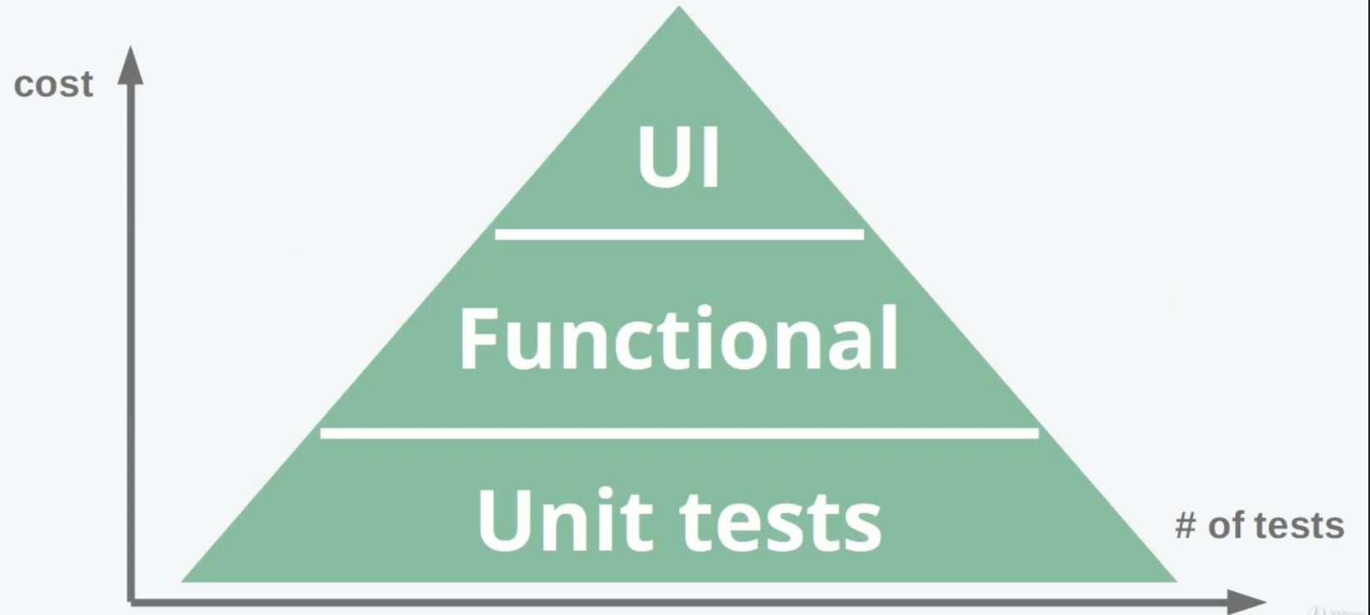
Test Pyramid!

Slide 11
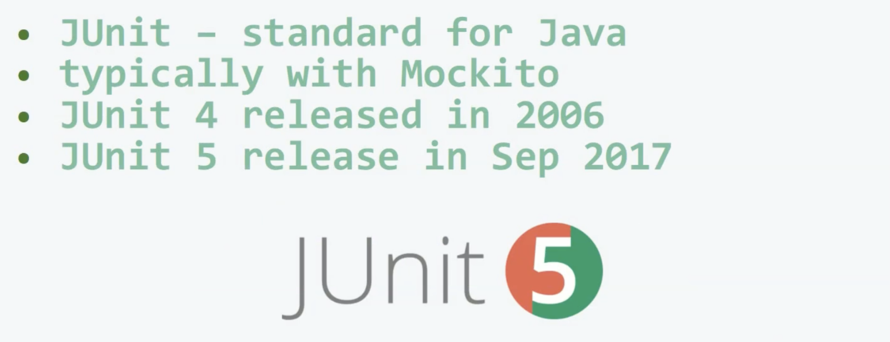
Junit Testing Framework!

Slide 12
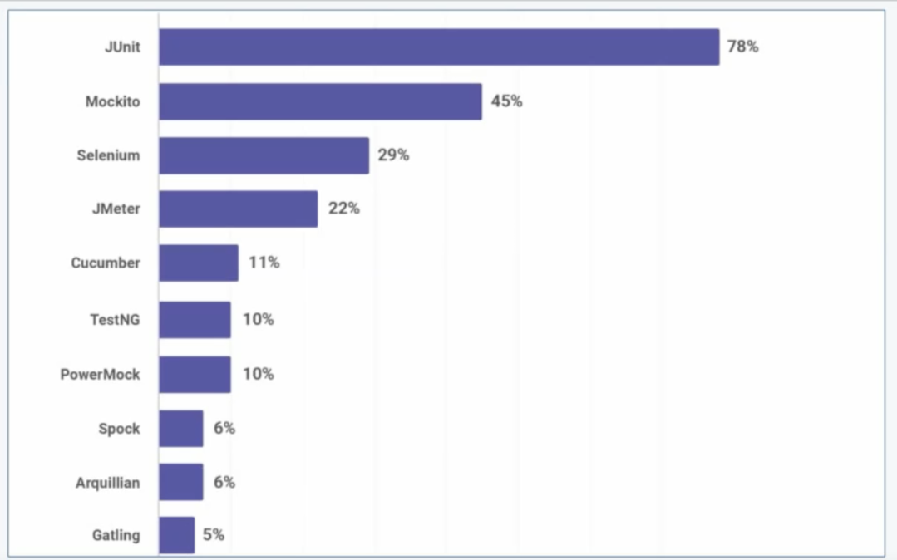
Junit Testing Framework!

Slide 13
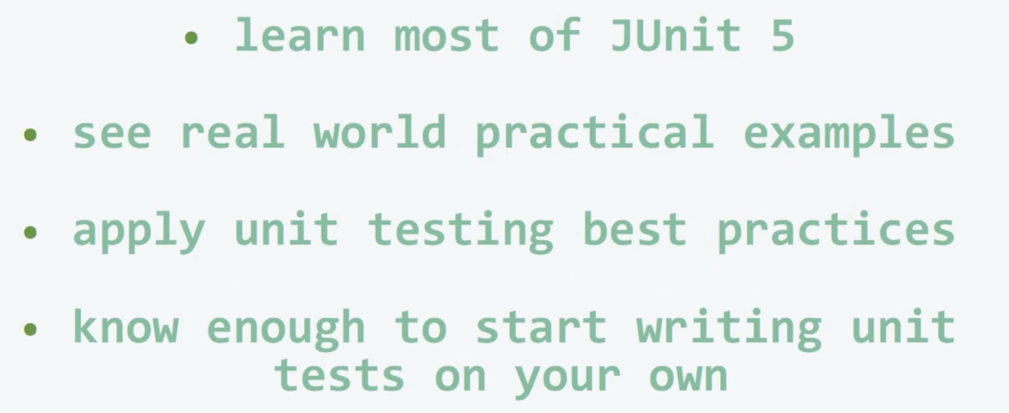
Objective Of This Course!

Slide 14
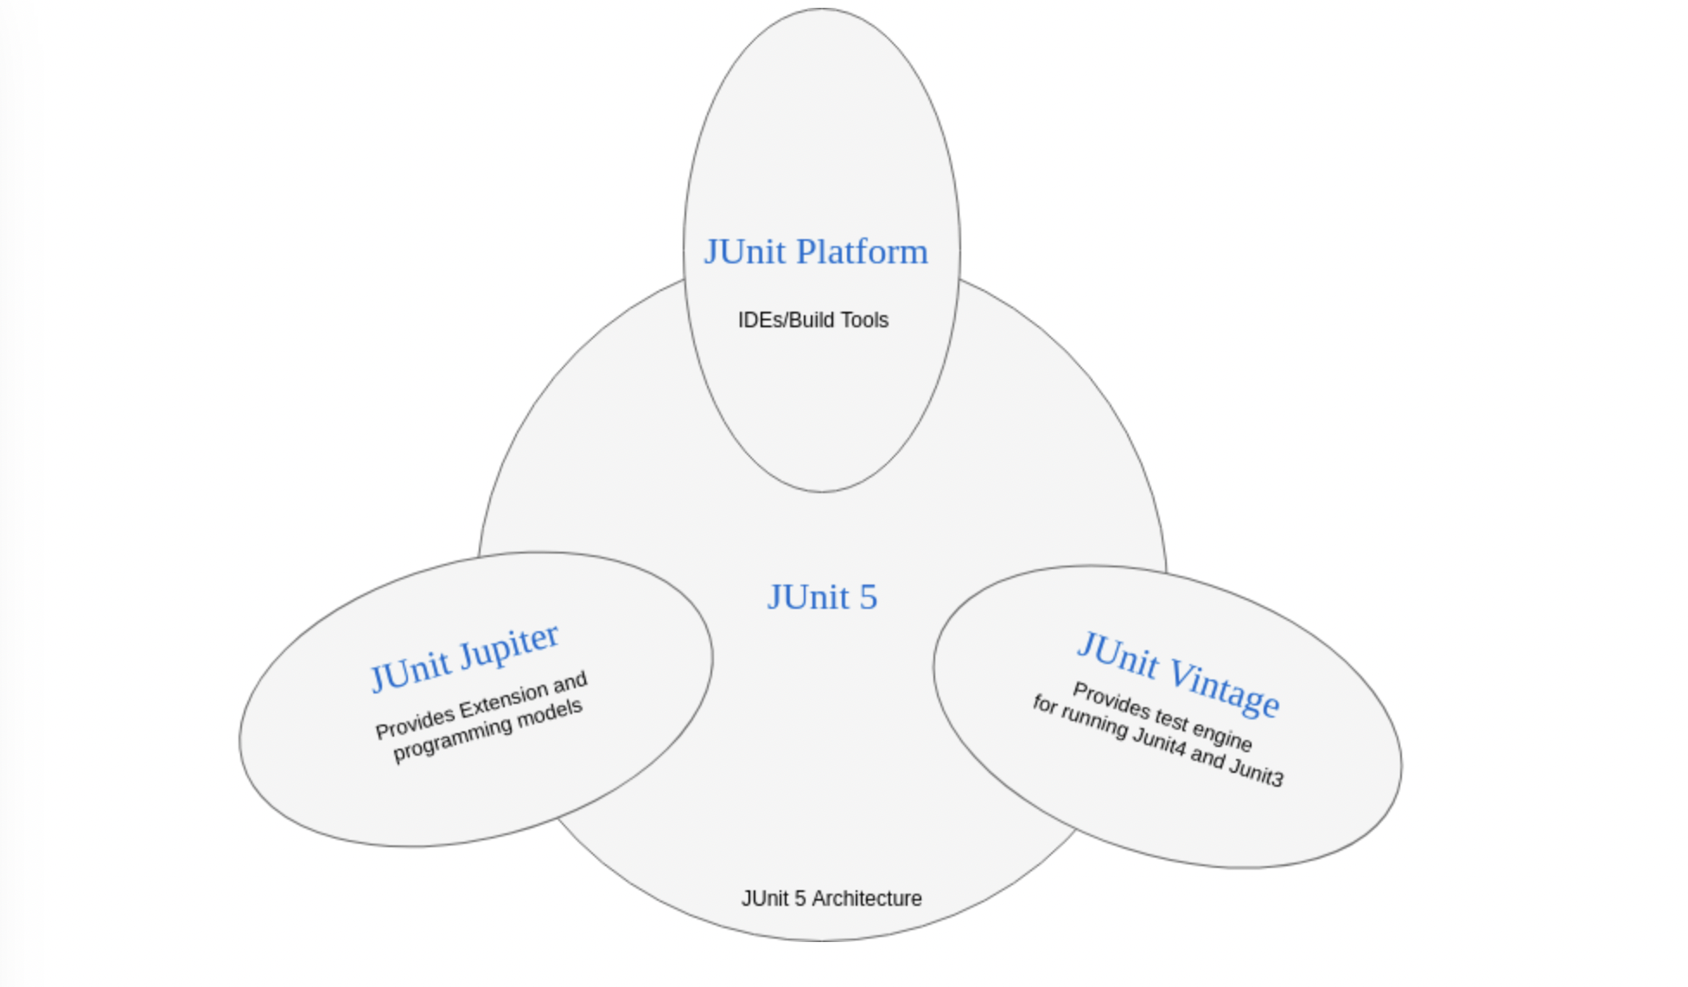
Junit-5 Architecture

Slide 15
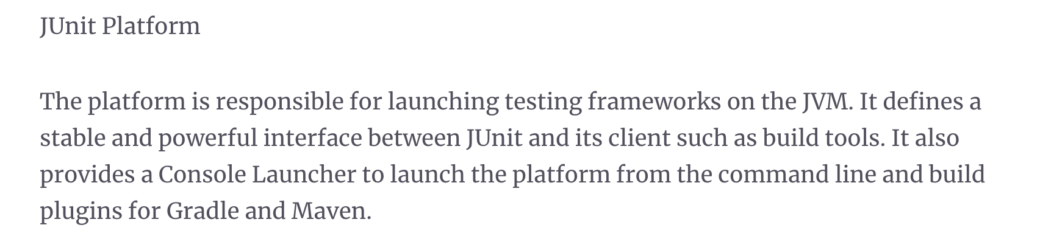
Junit-5 Architecture

Slide 16
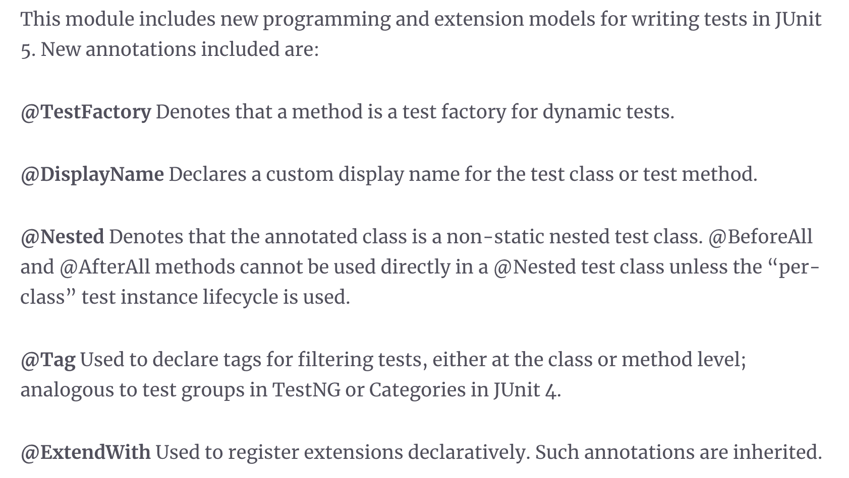
Junit-5 Architecture

Slide 17
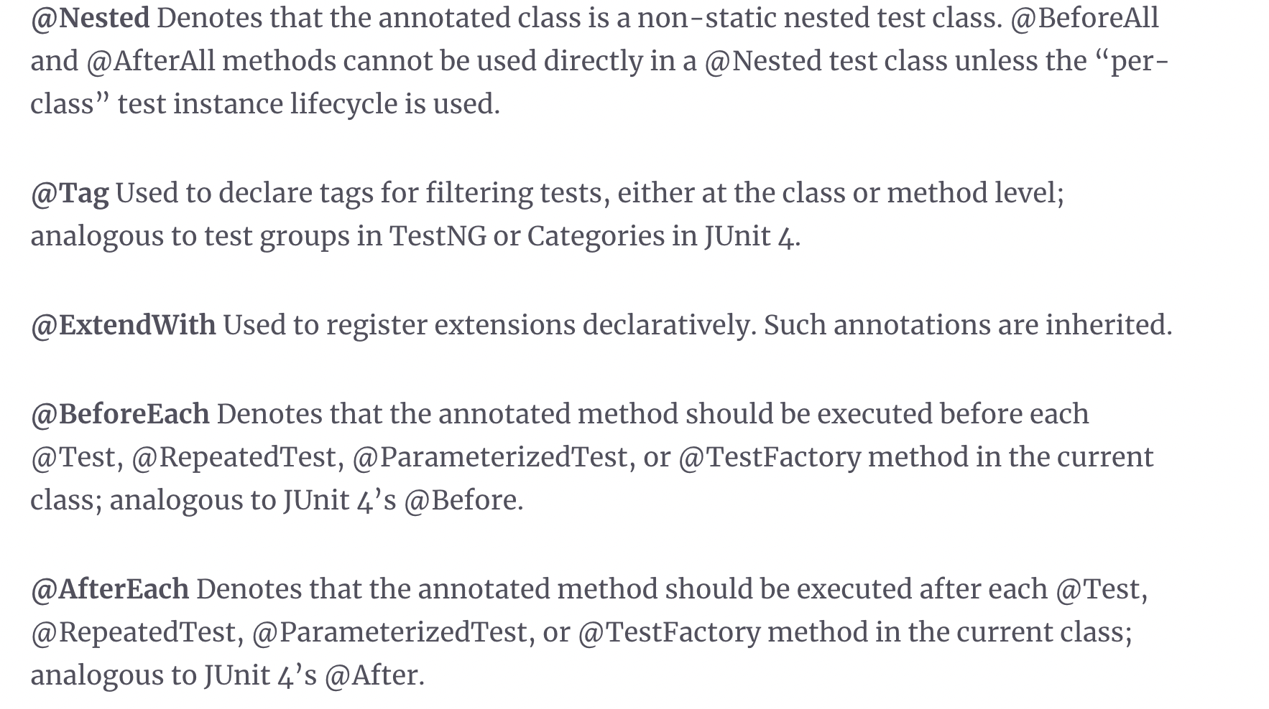
Junit-5 Architecture

Slide 18
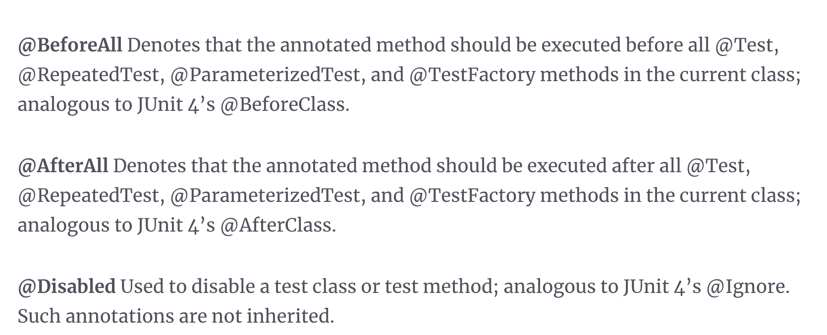
Junit-5 Architecture

Slide 19

Junit-5 Vintage

Slide 20
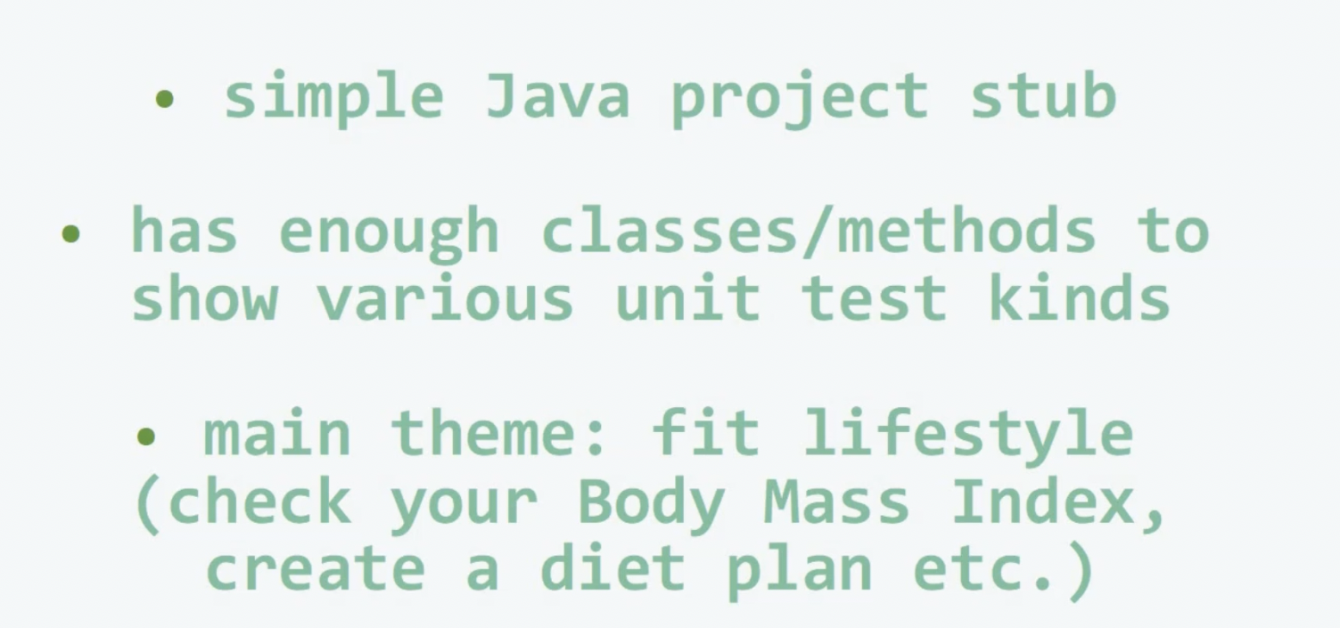
HealthyCoderApp- The Project To Do Unit Test.

Slide 21
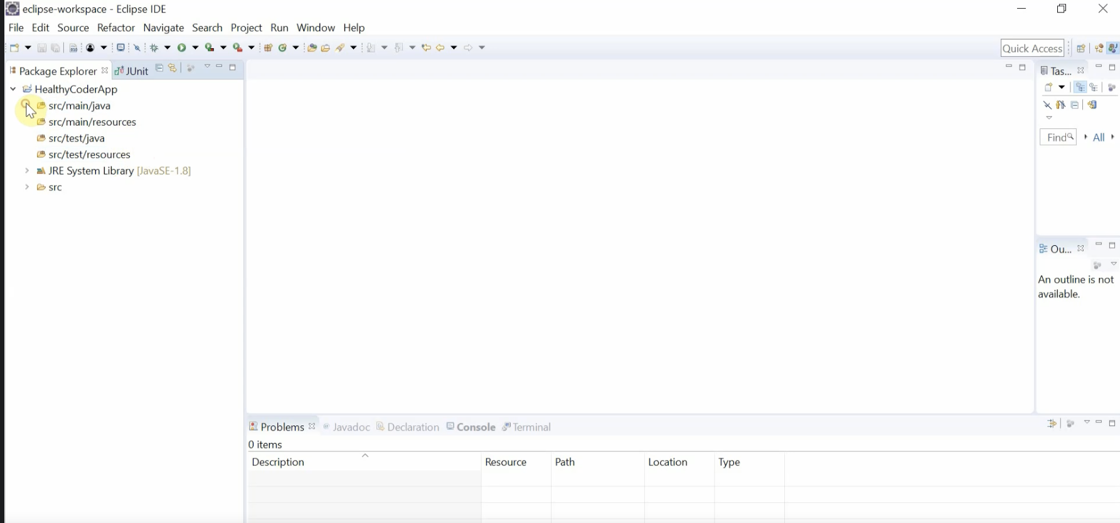
HealthyCoderApp- The Project To Do Unit Test.

Slide 22
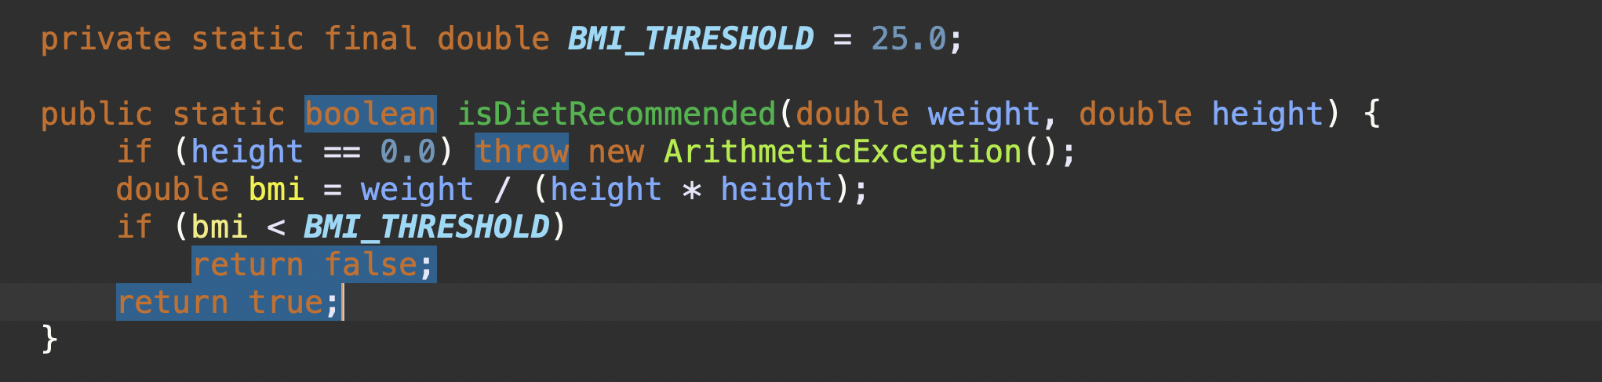
HealthyCoderApp- The Project To Do Unit Test.

Slide 23
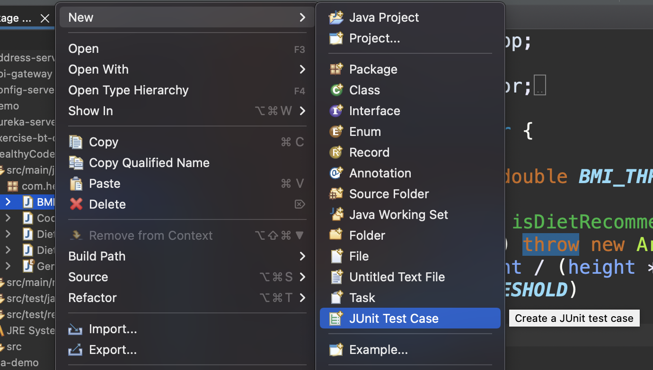
Create A Junit Test Case!

Slide 24
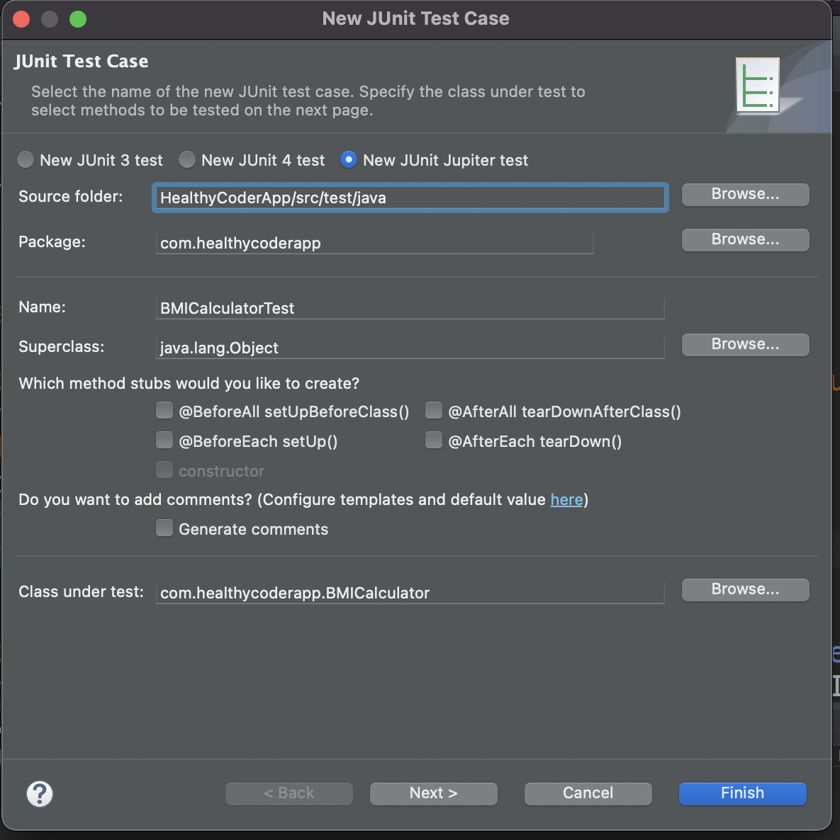
Create A Junit Test Case!

Slide 25
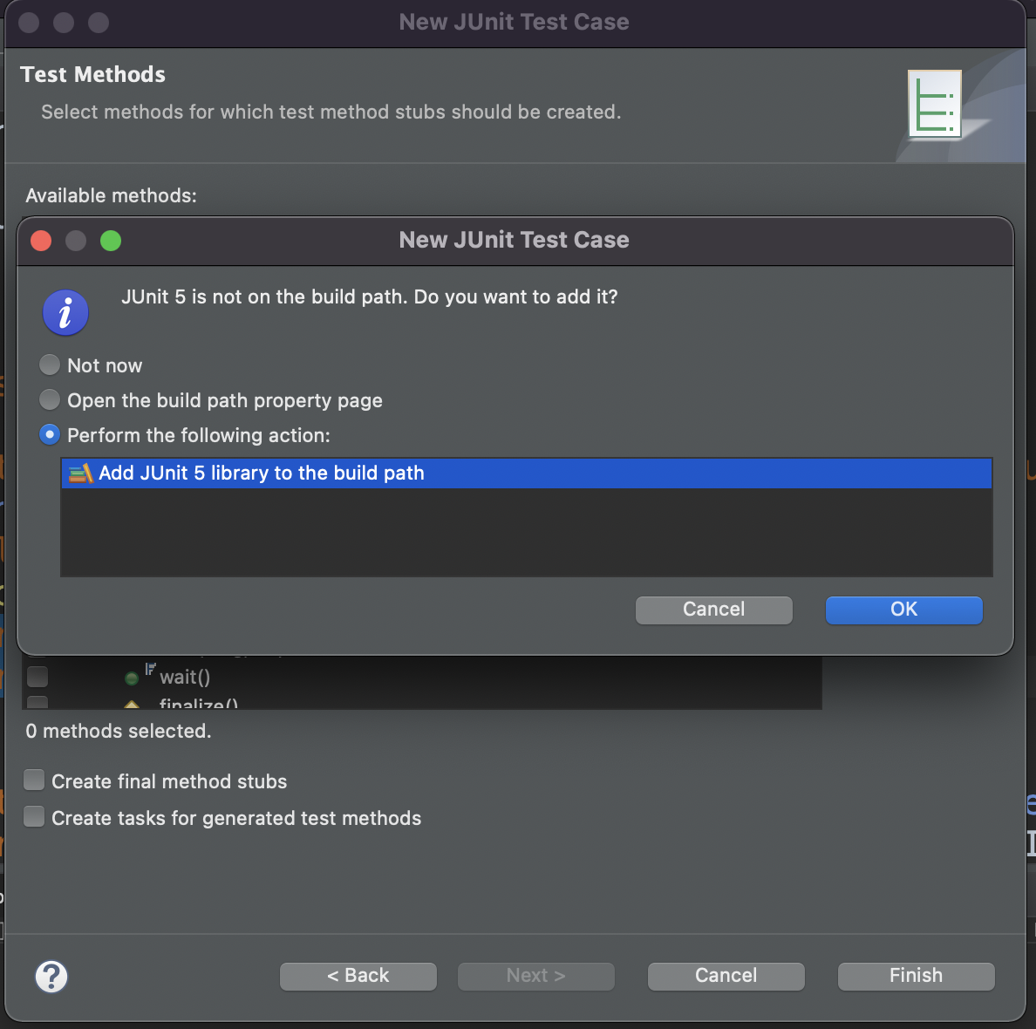
Create A Junit Test Case!

Slide 26
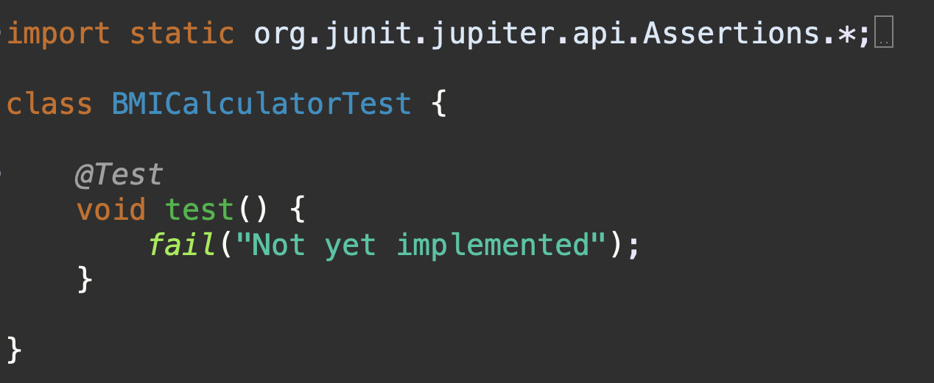
Create A Junit Test Case!

Slide 27
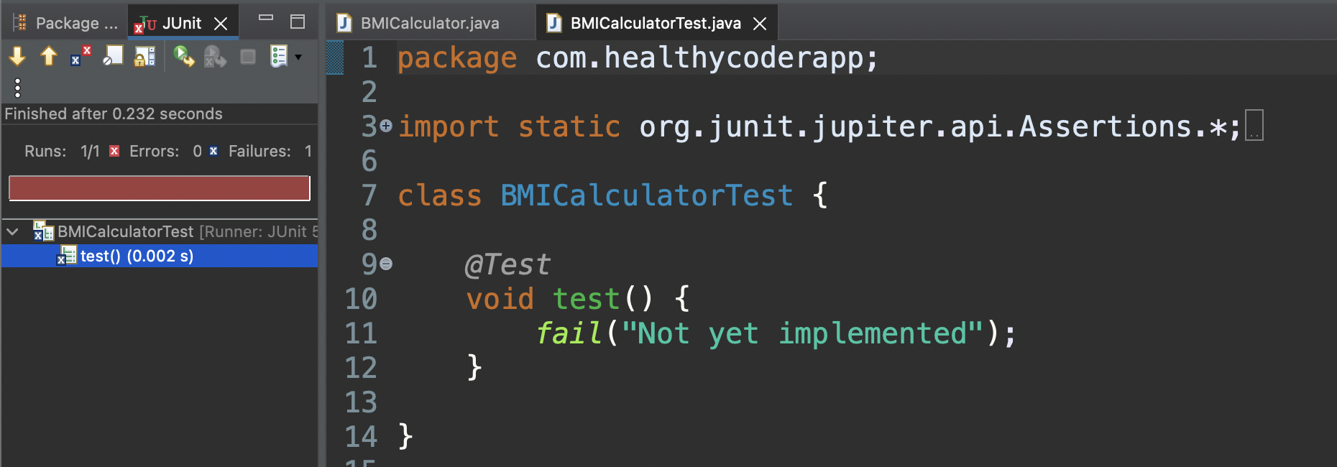
Test Fails!

Slide 28
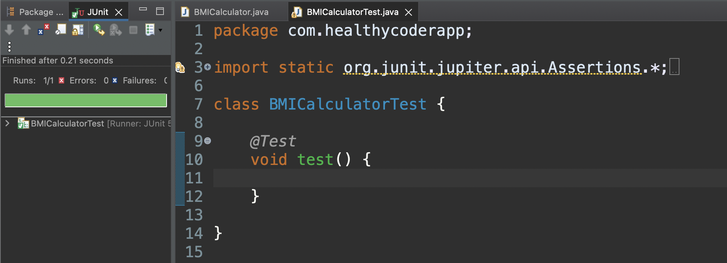
Test Passes Now!

Slide 29
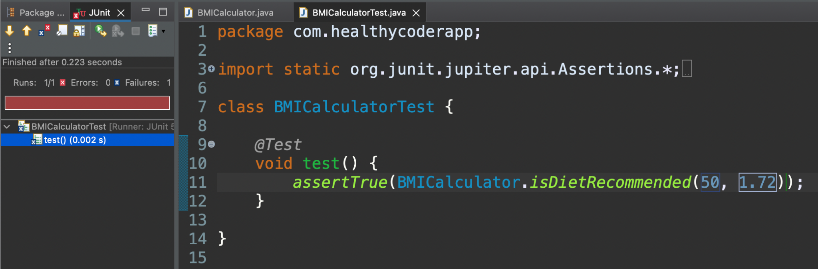
Test Fails As isDietRecommended returns False here

Slide 30
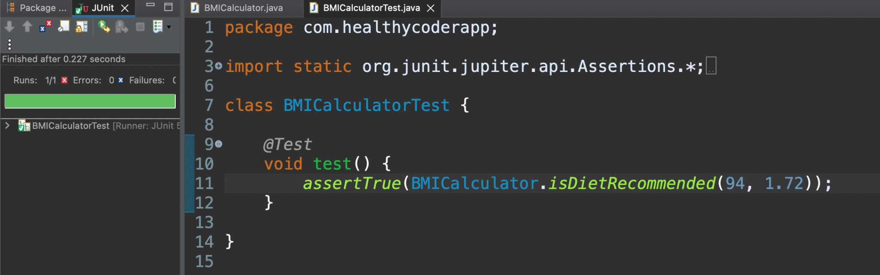
Test Passes As isDietRecommended returns True!

Slide 31
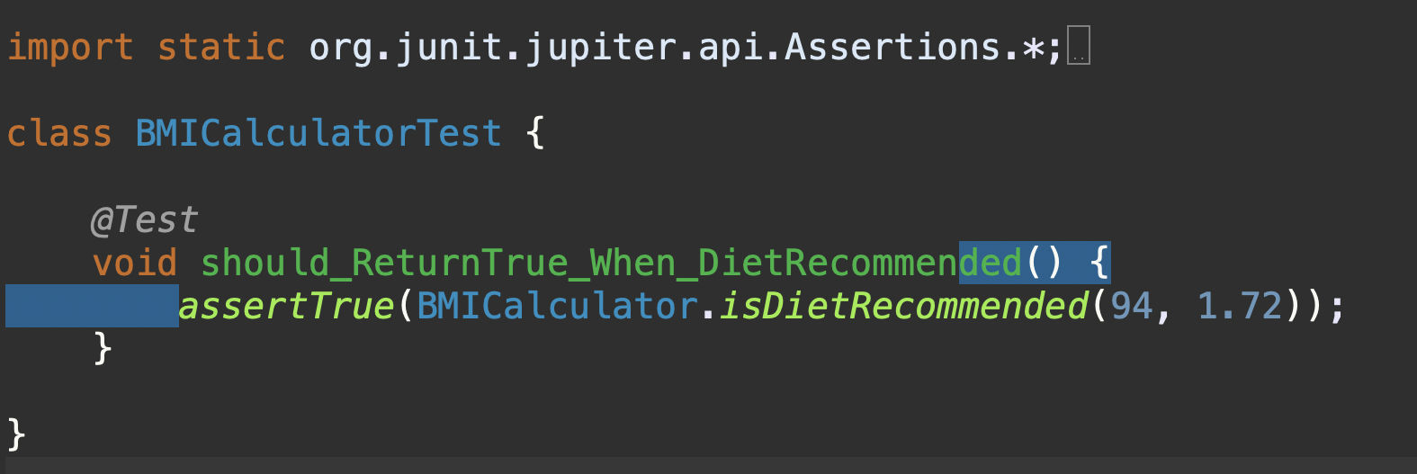
Naming The Test Case Method: Should_When

Slide 32
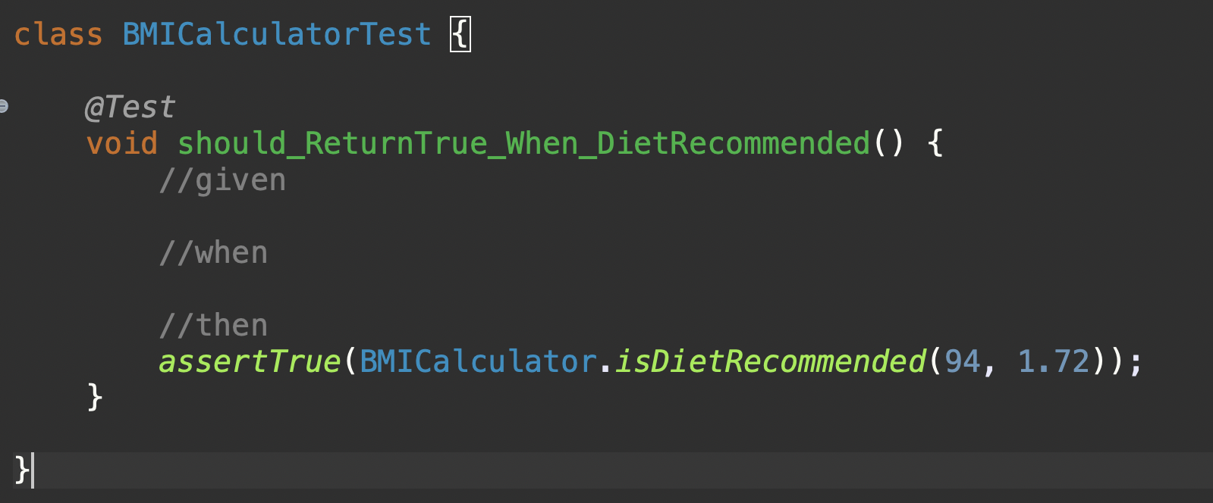
Given-When-Then (Arrange-Act-Assert)

Slide 33
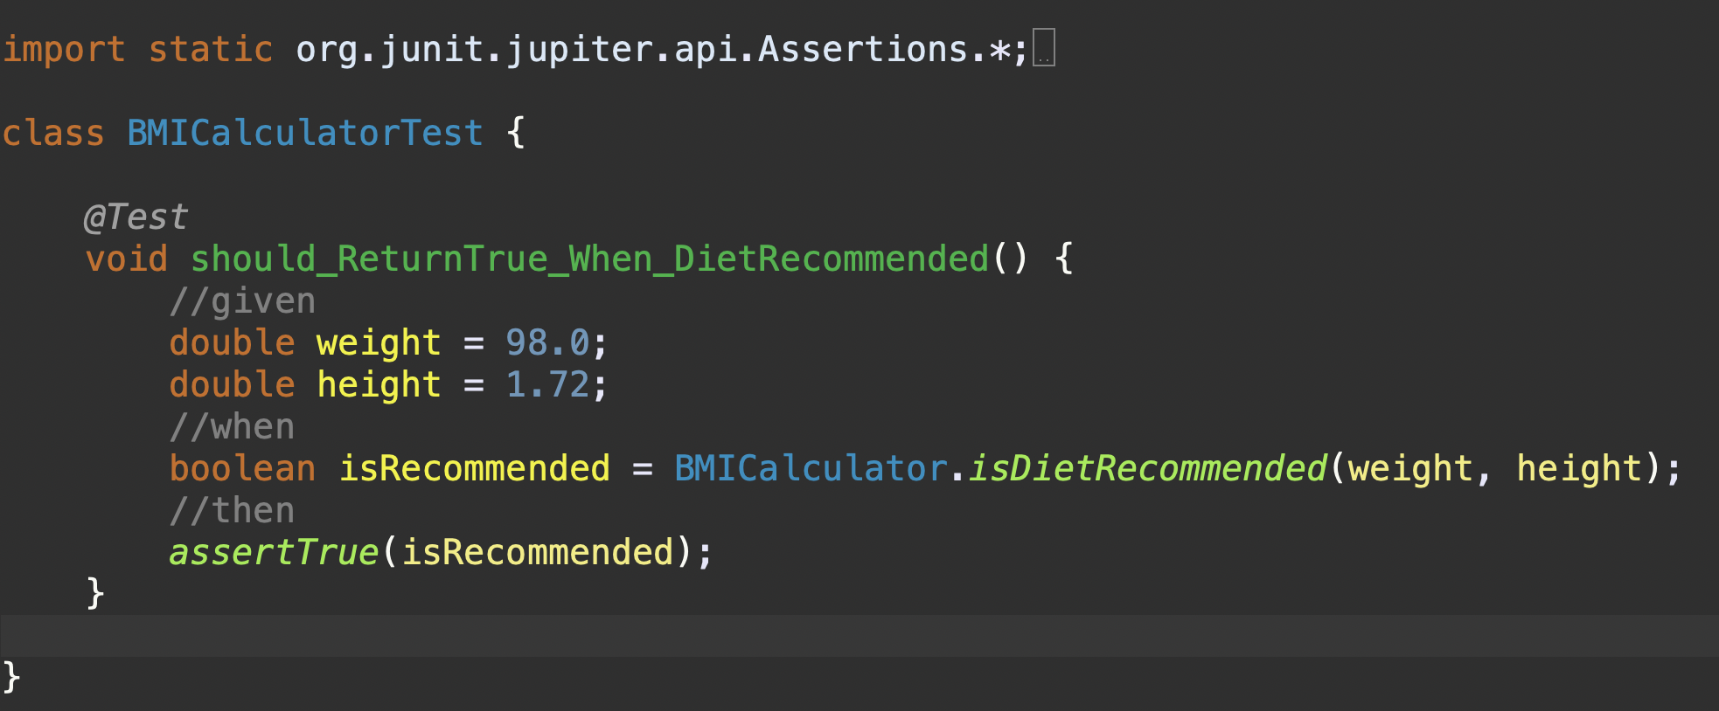
Given-When-Then (Arrange-Act-Assert)

Slide 34
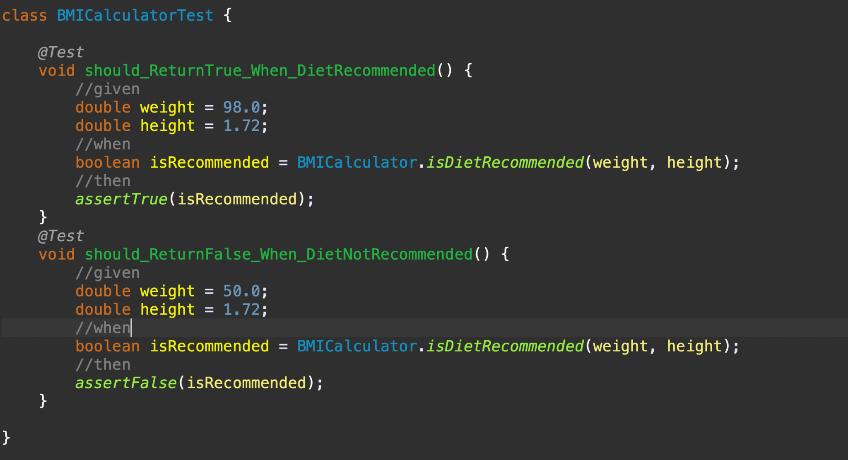
Given-When-Then (Arrange-Act-Assert)

Slide 35
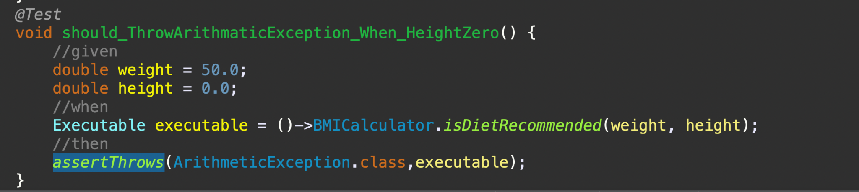
AssertThrows to Throw Exception

Slide 36
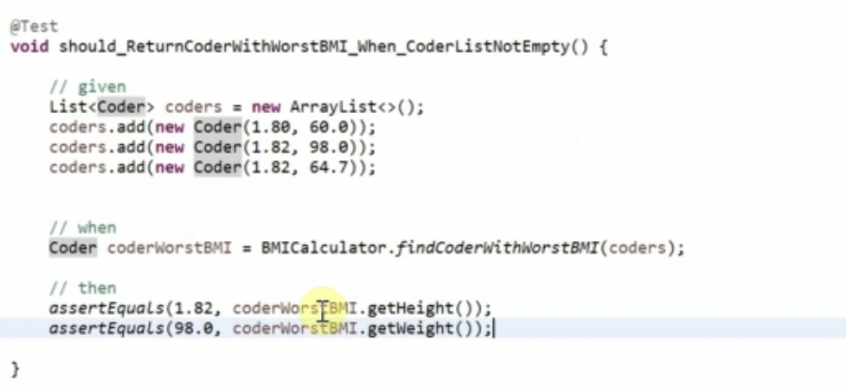
Multiple Assertions. If First Fails Next Will Not Run.

Slide 37
AssertAll(): For Multiple Assertions

Slide 38
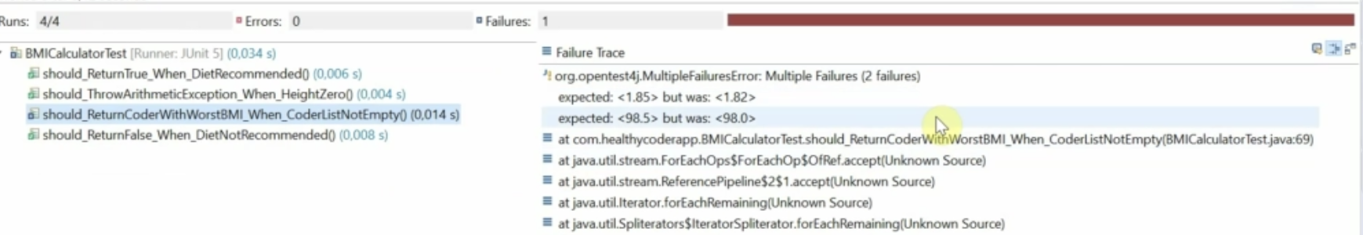
AssertAll(): For Multiple Assertions

Slide 39
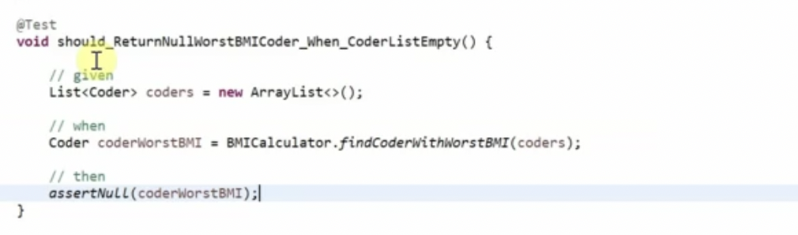
AssertNull(): To test Null

Slide 40
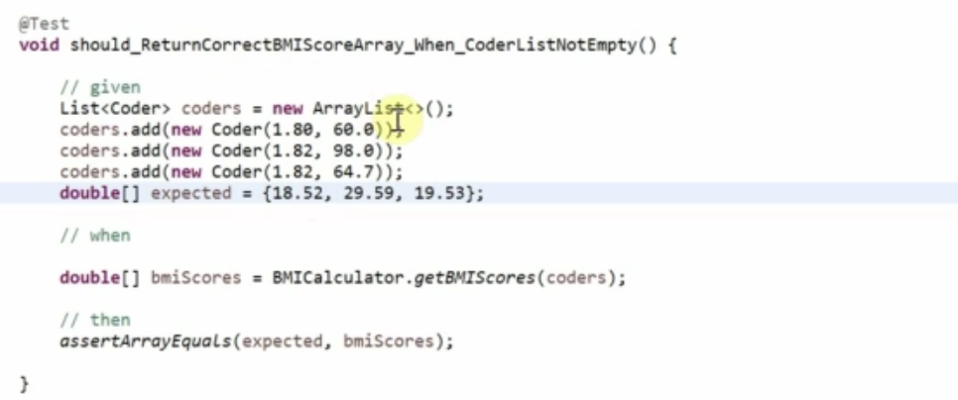
AssertArrayEquals(): test equality between Arrays

Slide 41
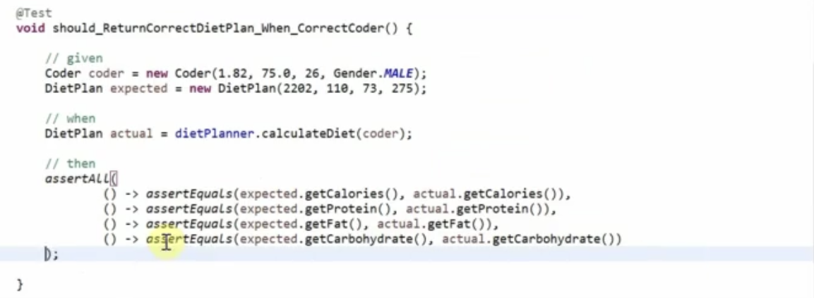
AssertAll(): test Object Equality

Slide 42
AssertAll(): test Object Equality

Slide 43
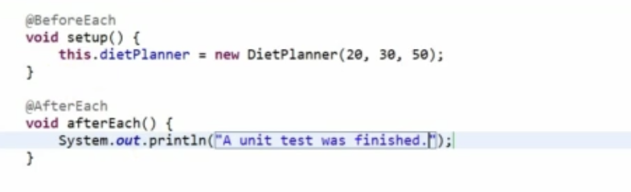
@BeforeEach & @AfterEach Annotations

Slide 44
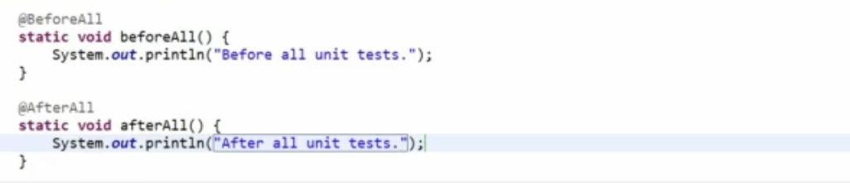
@BeforeAll & @AfterAll Annotations

Slide 45
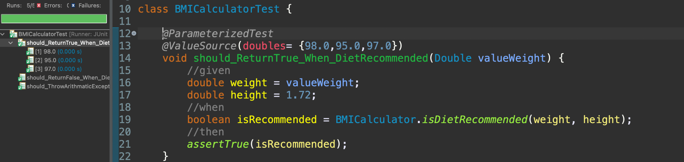
@ParameterizedTest & @ValueSource

Slide 46
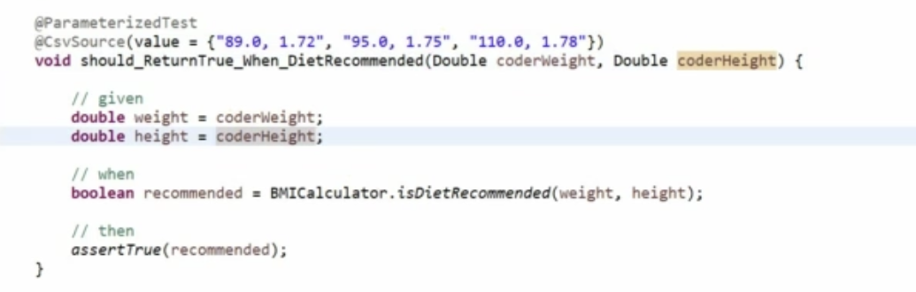
@ParameterizedTest & @CsvSource

Slide 47
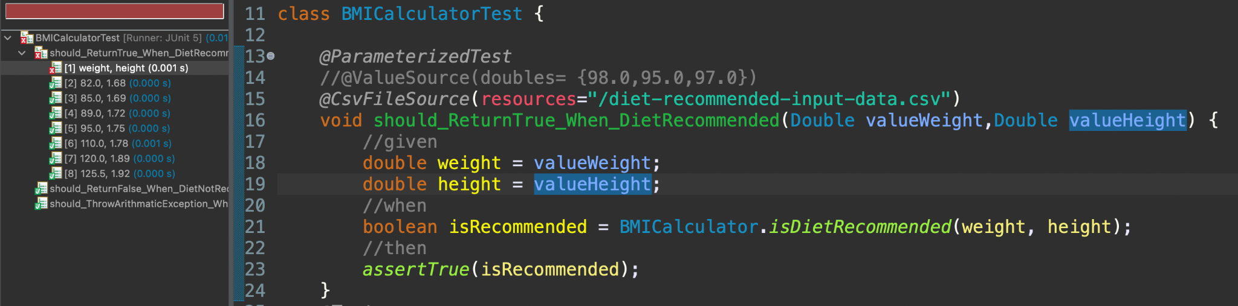
@ParameterizedTest & @CsvFileSource

Slide 48
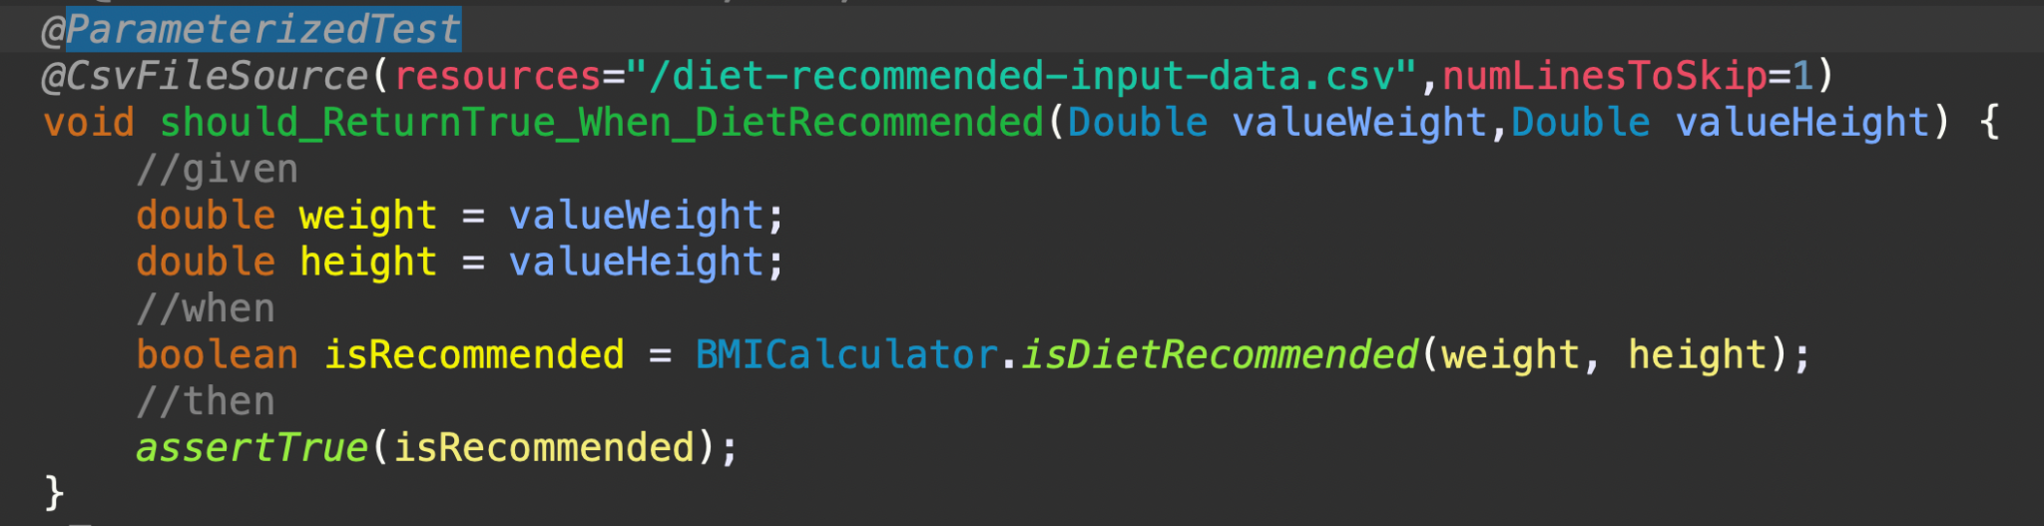
@CsvFileSource and numLinesToSkip

Slide 49
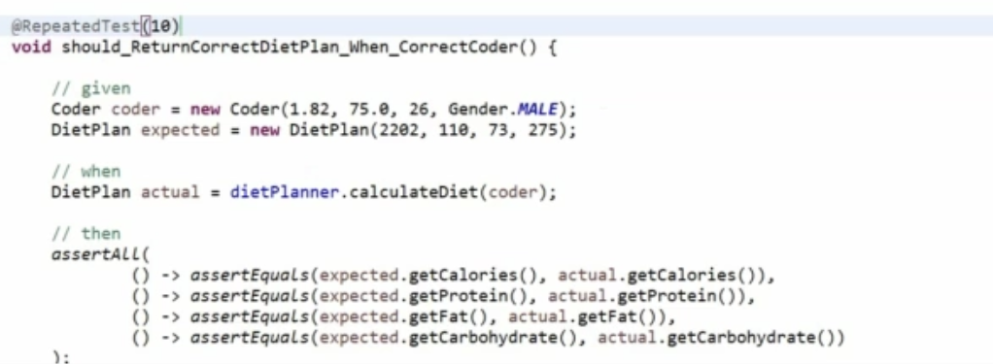
@RepeatedTest(count)

Slide 50
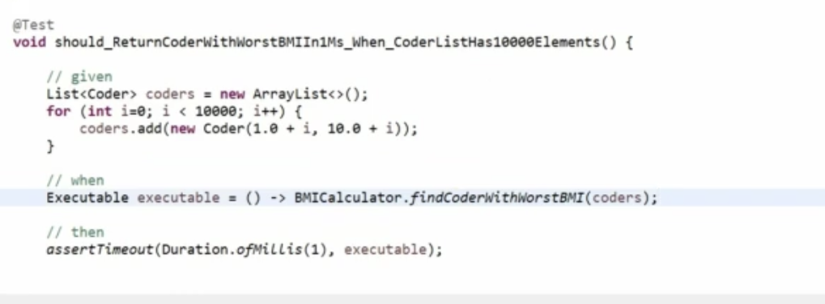
Performance

Slide 51
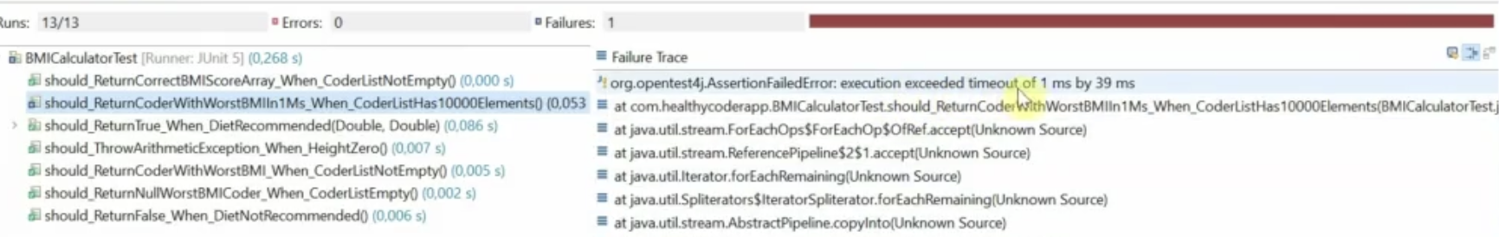
Performance

Slide 52

AssumeTrue()

Slide 53
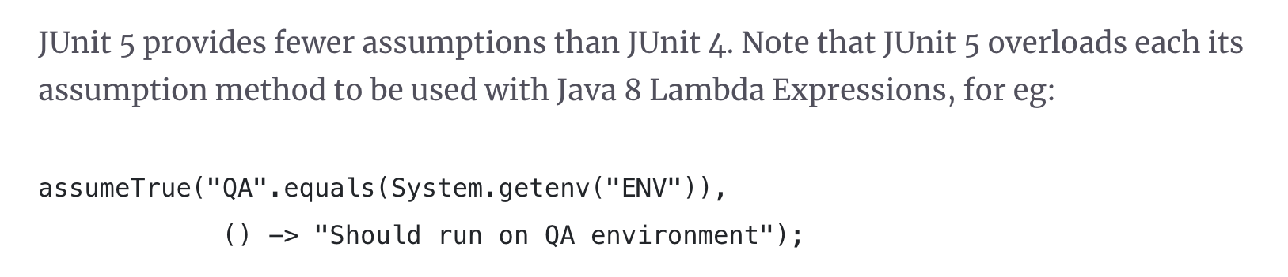
AssumeTrue()

Slide 54
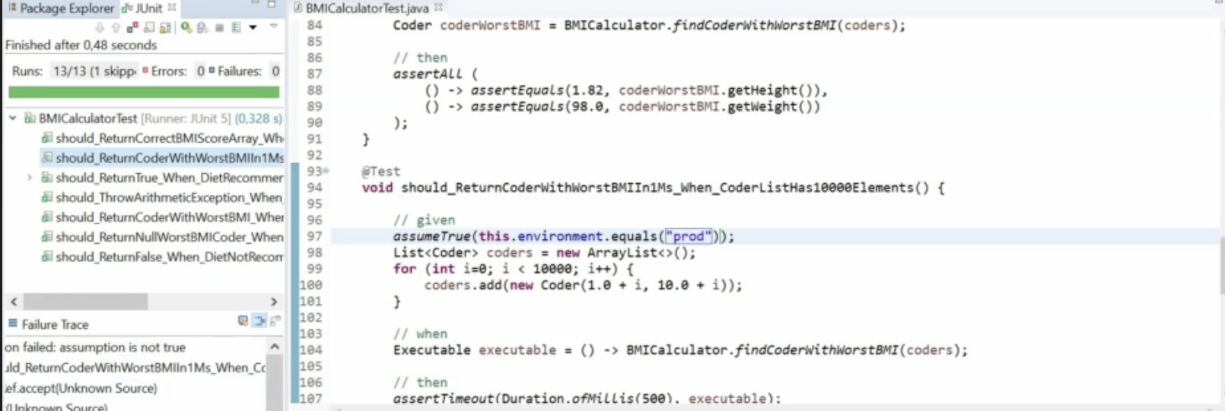
AssumeTrue()

Slide 55
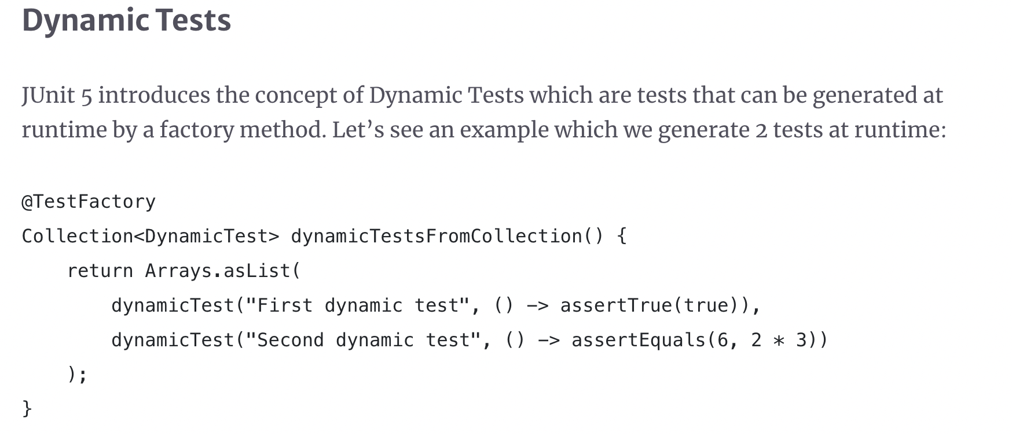
Dynamic Test

Slide 56
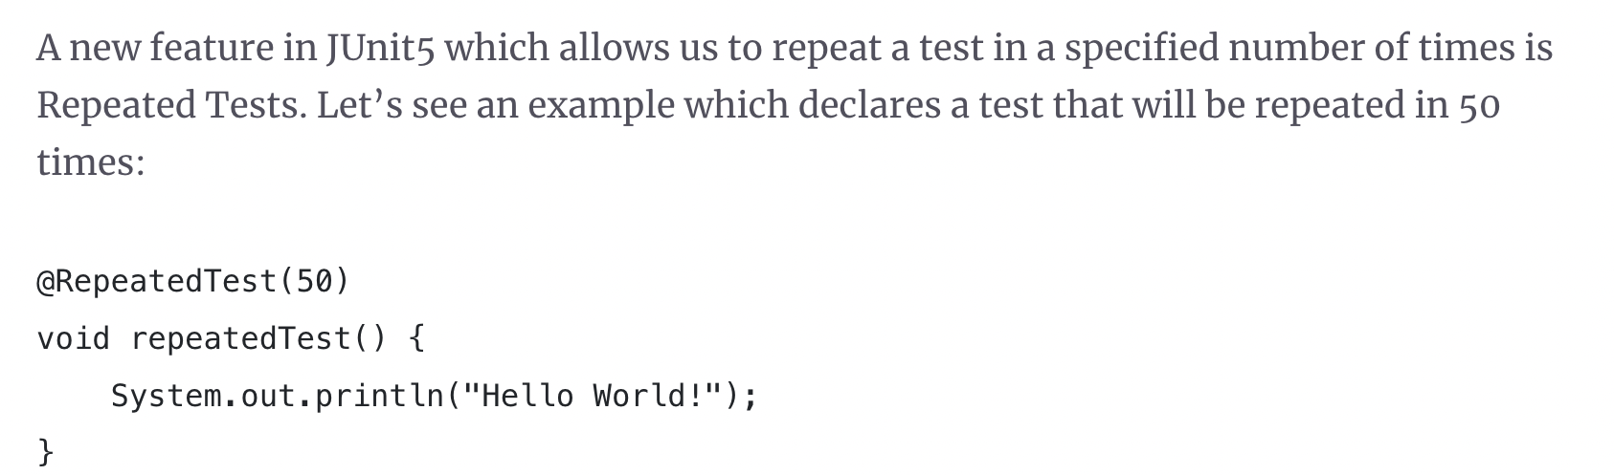
Repeated Test

Slide 57
Repeated Test

Slide 58
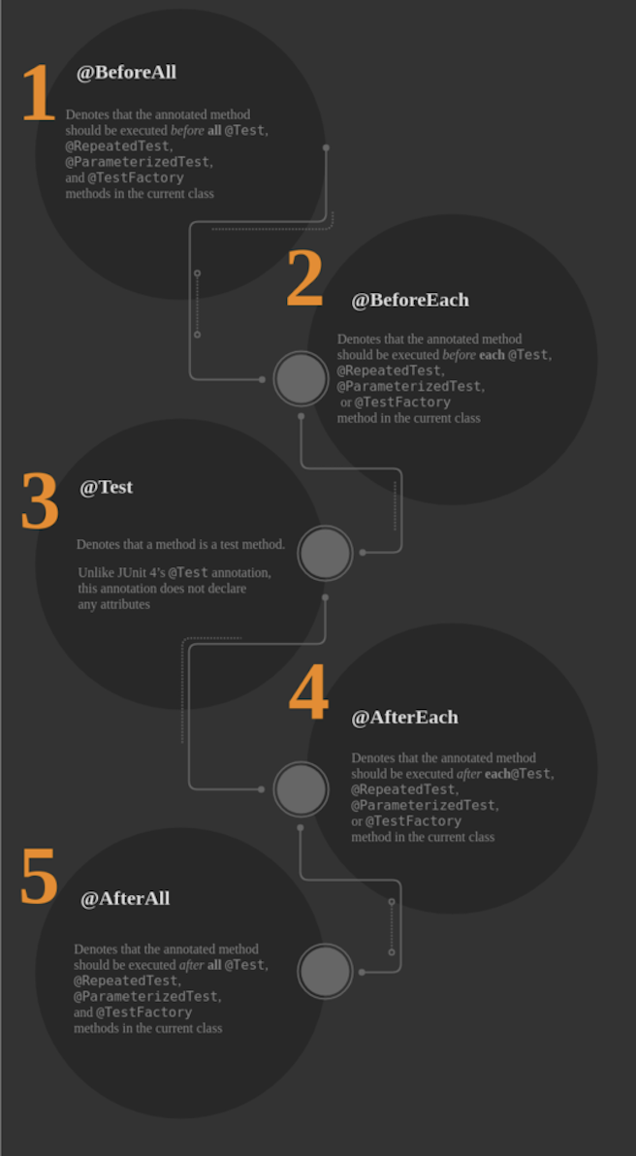
Life Cycle of A Test Class

Slide 59
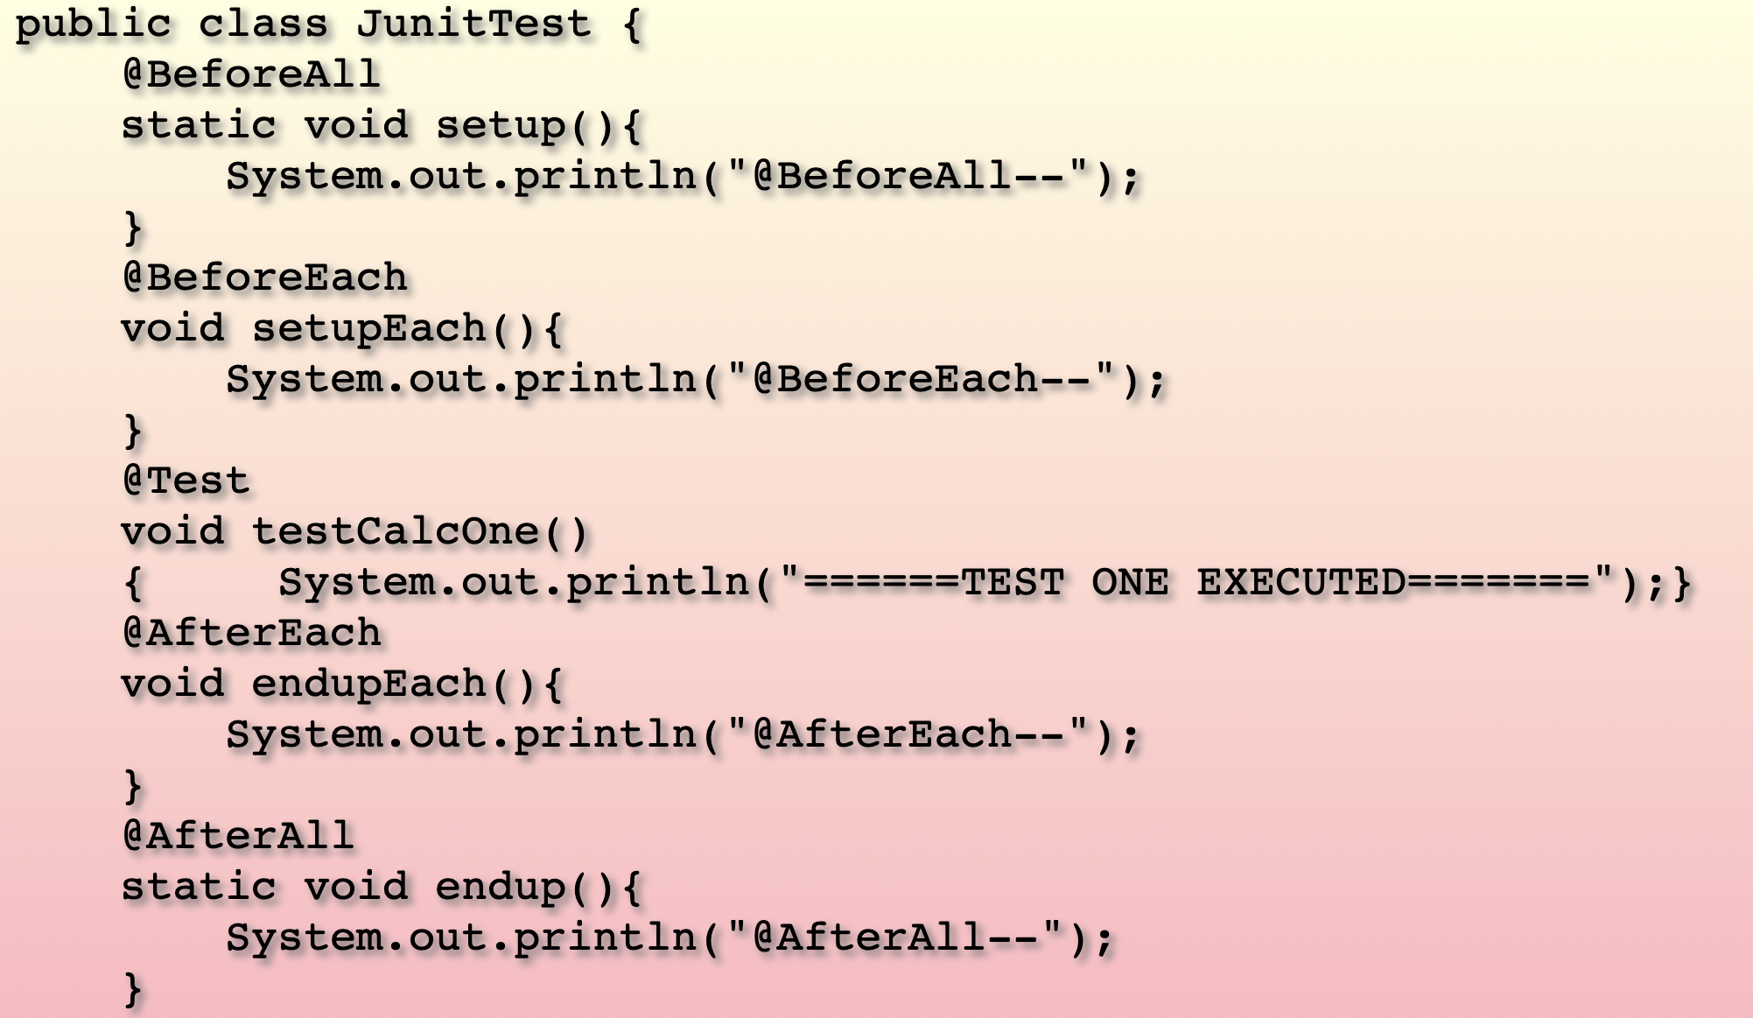
Life Cycle of A Test Class

Slide 60

Life Cycle of A Test Class

Slide 61

Life Cycle of A Test Class

Slide 62

Difference between Junit 4 and Junit 5

Slide 63

Difference between Junit 4 and Junit 5

Slide 64

Unit Test Case Cheat Sheet

Slide 65

Unit Test Case Cheat Sheet

Slide 66

Unit Test Case Cheat Sheet

Slide 67

Unit Test Case Cheat Sheet

Slide 68

Unit Test Case Cheat Sheet

